Slide 1

MANULIFE HK · DEVOPS & PLATFORM
01
EXECUTIVE PROPOSAL
AIOps Platform Proposal
Move from people-heavy firefighting to governed, AI-assisted operations.
WHAT THIS MEETING DECIDES
1) Formalize AIOps as an internal program. 2) Confirm Q2/Q3 execution priority and headcount support.
May 2026
Notes:
Cover — Frame this as a decision deck, not a research readout. — The ask is formal sponsorship and phased resourcing.

Slide 2
CURRENT STATE
02
The operating model is already under strain
Internal signals show a concentration of operational friction. The issue is not isolated inefficiency; it is a scaling limit in how work gets deployed, investigated, and coordinated.
SURVEY BASE
RELEASE / DEPLOYMENT FRICTION
136
118
Internal respondents from the HK DevOps & Platform team.
Most frequently raised pain point across the survey.
JENKINS INCIDENT PAIN
SERVICE FOOTPRINT
83
~500
Services already sit under the HK Marketing estate while manual intervention remains high.
A recurring operational drain; 54% voted it the hardest tool to use.
Executive reading: service scale keeps growing, but the operating model still depends on human coordination and reactive firefighting.
Notes:
Current strain — These figures are internal signals, not market benchmarking. — The point is that operating complexity is already ahead of the current manual model. — Confirm the final counting logic behind the "~400 services" figure before the meeting.

Slide 3

CORE JUDGMENT
03
“
Operations scale has outgrown what headcount alone can cover.
Our answer is AIOps: AI-assisted, proactive, and governed DevOps.
This is not a concept pitch; it is a formalization ask for a direction already in motion.
Decision slide
Notes:
Core judgment — The core claim is that more people alone will not fix the operating model. — We need AI-assisted, governed leverage in the delivery and incident loop.

Slide 4
LIVE PROOF
04
This direction is already producing working proof
Two low-cost implementations have already validated the path.
LIVE PROOF 01
LIVE PROOF 02
Pipeline AI L1
miniops 1.0
Pipeline failure triggers RCA automatically.
Result is written back into Jenkins build description.
First-level diagnosis now lands in under 30 seconds.
Release flow is coordinated from one interface.
Multiple pipeline steps are no longer kicked off one by one.
The team is already using it to simplify day-to-day delivery work.
BEFORE
NOW
BEFORE
NOW
Dozens of repetitive steps
15–60 min
< 30 sec
One key
Notes:
Live proof — Emphasize that both examples are already running with low-cost implementation paths. — Pipeline AI L1 proves faster first-level diagnosis. — miniops proves release orchestration can move from repetitive manual coordination to a single controlled entry point.

Slide 5
05
AIOps grows through three connected capability tracks.
Execution principle: lead with UC1 now; let UC2 and UC3 build on the same agent and service context foundation.
PRIMARY TRACK · PHASE 1 FOCUS
SHARED LAYER NEXT
SHARED LAYER NEXT
UC1 · Delivery & Release Intelligence
UC2 · Monitor Recovery
UC3 · Cost Intelligence
Observe, diagnose, then automate safely.
Operational efficiency with financial visibility.
Most direct path to user-visible value.
Proactive monitoring signal intake.
RCA assistance and evidence chain.
Non-production auto-fix as the safe proving ground.
Cloud cost observability and tagging discipline.
Actionable recommendations, not passive reporting.
Daily agent pattern once the data quality foundation is ready.
Pipeline AI L1 is already live.
L2 / L3 and miniops 2.0 are the most practical next steps.
This is the wedge that proves platform leverage in daily engineering work.
Notes:
Strategic tracks — UC1 is the near-term wedge because value is closest to production reality. — UC2 and UC3 reuse the same agent and service context foundation. — Do not let the room interpret this as three equal workstreams starting at once.

Slide 6
RETURN ON INVESTMENT · 1 OF 2
06
Pipeline AI cuts resolution time from hours to seconds.
MONTHLY BUILD / DEPLOY INCIDENTS
AVG RESOLUTION TIME
50+
1.7h
<30s
→
avg per month today
now · fully manual
AI target · 90% of cases
↑ Growing with AliCloud migration
Manual capacity does not scale with volume increase.
Every incident today is a blocking human investigation — engineers cannot ship until it is resolved.
AliCloud migration is actively increasing incident frequency; the trend will continue through H2.
Pipeline AI targets 90% auto-resolved in <30 seconds — engineers see a diagnosis, not a war room.
1.7 hours of human firefighting → 30 seconds of AI diagnosis. The team gets back to building.
Notes:
ROI expectations — Two columns: human efficiency (MTTR) on the left, FinOps cost saving on the right. — The xx placeholders for monthly incident count and average resolution time need real numbers before the meeting — expect VP to ask. — For FinOps: the 100K → 1M+ framing is the key argument. Make clear that 100K came from one manual pass on one resource type; 1M+ is what systematic AI coverage of Redis / Kafka / deployment requests can unlock. — The anchor line at the bottom is the mic-drop: one manual review finds one dimension, AI finds all of them continuously.

Slide 7
07
FinOps AI turns one lucky find into systematic saving.
ONE MANUAL REVIEW · Q1 2025
AI FINOPS · BAU CADENCE
$100K
$??
→
saved / year · DB downgrade · fully manual
optimisation potential · all resource types
Single engineer · single resource type
Continuous · systematic · zero extra headcount
DB (done ✓)
Redis
Kafka
Deployment requests
Other cloud resources
… untouched today
The Q1 DB downgrade proved the concept — but it took a dedicated human investigation and covered only one resource type.
Redis, Kafka, deployment requests, and a long tail of cloud resources have never been reviewed for right-sizing.
An AI FinOps agent running at BAU cadence surfaces waste across all layers, continuously — no extra headcount required.
$100K was what one person found in one place. $1M+ is what AI finds everywhere, every sprint.
Notes:
Governance — Say this explicitly: AI can recommend, but production action remains human-approved. — Keep the main slide principle-led. — Use Appendix C if the room wants architecture and security-governance detail.

Slide 8
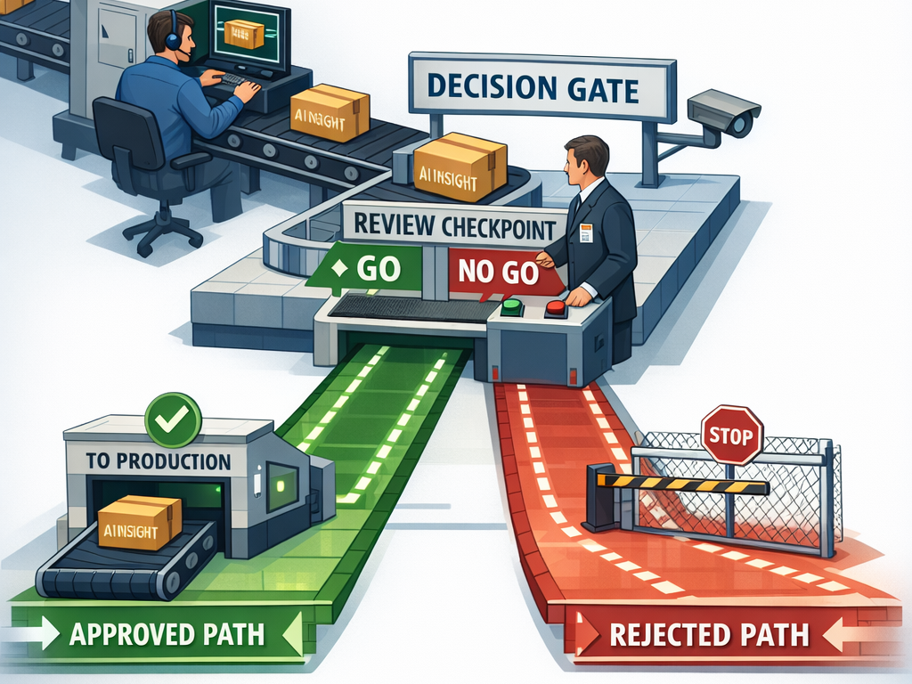
GOVERNANCE & SECURITY
08
NON-NEGOTIABLE DESIGN RULE
AI can recommend. Only humans can execute production change.
Built for governed adoption, not blind automation.
Evidence before action
Every AI decision must be backed by observable data and a traceable evidence chain.
Human approval for production
Production actions stay behind mandatory approval gates aligned with ITIL process.
Minimum permissions by design
Each agent receives only the access needed for the task it is assigned.
Governance is part of the product, not a post-hoc control layer.
See Appendix C
Notes:
Roadmap — Foundation first. Do not let the conversation drift into all-three-tracks-at-once staffing. — Q2 is the critical path.

Slide 9
ROADMAP
09
Deliver in phases. Do not industrialize everything at once.
Foundation first. First deliveries next. Deeper capability after the substrate is real.
Q2 2026
Q3 2026
Q4 2026
Foundation
First deliveries
Deeper capability
Jenkins Agent standardization
Service Catalog MVP
miniops 2.0 MVP
Pipeline AI L2
AIOps Dashboard v1
Documentation reorganization
UC3 cost observability
UC2 monitoring RCA MVP
Pipeline AI L3
Non-production auto-fix
UC3 daily agent pattern
Notes:
Resource ask — This is a staged ask, not an open-ended platform budget. — Appendix A has role-level detail if requested.

Slide 10
RESOURCE ASK
10
To deliver in phases, we need staged resourcing
A specific phased ask, not an open-ended platform budget.
Q2 ASK
Q3 ASK
3.5 FTE
2.5 FTE
Build the foundation
Extend into first deliveries
Service Catalog MVP
miniops 2.0 MVP
Jenkins Agent standardization
Pipeline AI L2
AIOps Dashboard v1
Documentation reorganization
Critical path for the rest of the platform.
Appendix A contains the role-level split behind these numbers.
Notes:
Decisions — End on decisions, not on a summary. — The meeting should leave with a sponsor signal and a priority signal.

Slide 11
DECISION PAGE
11
Today we ask for two decisions
End on sponsorship and execution priority — not on summary.
DECISION 01
DECISION 02
Approve AIOps as a formal internal program
Confirm Q2 / Q3 priority and headcount commitment
Move beyond informal team-led momentum.
Establish explicit sponsor and steering support.
Give the direction governance visibility and operating legitimacy.
Q2 first: the foundation layer.
Q3 next: L2, dashboard, and documentation uplift.
Resource the validated path instead of spreading effort across all ambitions at once.
Notes:
Appendix A — Use only if the room asks how 3.5 FTE and 2.5 FTE are allocated.

Slide 12
APPENDIX A · HEADCOUNT DETAIL
12
Role-level breakdown behind the phased ask
Q2 · 3.5 FTE
Q3 · 2.5 FTE
R1 · Service Catalog MVP data onboarding
R4 · Documentation reorganization lead / TL
0.5 FTE
1.0 FTE
R2 · Full Stack Developers for miniops 2.0 MVP
R5 · DevOps engineer for Pipeline AI L2
2.0 FTE
0.5 FTE
R3 · DevOps engineer for Jenkins Agent standardization
R6 · Full Stack Developer for AIOps Dashboard v1
1.0 FTE
1.0 FTE
Notes:
Appendix B — Risks are here to show control, not to dilute the proposal. — Keep mitigation phrasing practical and owned.

Slide 13
APPENDIX B · RISKS & MITIGATION
13
Key risks are known — and already bounded by practical mitigation
RISK 01
RISK 02
Copilot Studio RAG remains a black box
No CMDB / Service Catalog baseline today
Start with documentation reorganization now; keep a self-hosted RAG fallback if the black-box limit becomes material.
Make Service Catalog MVP part of phase 1 instead of treating it as a dependency someone else must solve first.
RISK 03
RISK 04
LLM variability may produce unsafe repair suggestions
Cloud billing tags are not aligned enough for deeper UC3 work
Use evidence chains, confidence thresholds, and mandatory human-in-the-loop approval for production actions.
Run tag validation and data-quality cleanup before moving into UC3 phase 2 automation.
Notes:
Appendix C — This appendix carries the detailed architecture and governance follow-through so the main governance slide can stay clean. — Shared agent layer and human gate placement are intentionally shown here at a higher level only. — Blueprint link for deeper implementation detail: https://manulife-asia.atlassian.net/wiki/spaces/HKDO/pages/1648525895/AIOps+blueprints

Slide 14
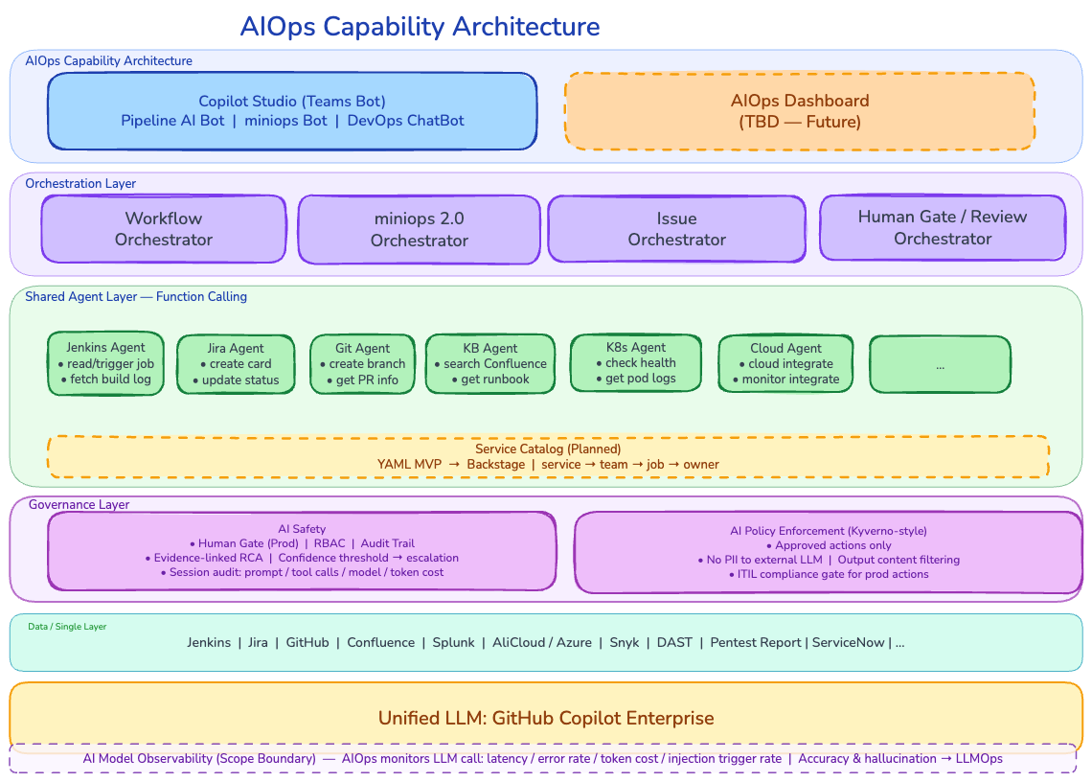
APPENDIX C · ARCHITECTURE & SECURITY GOVERNANCE
14
Detailed architecture and governance design
WHAT THIS APPENDIX CLARIFIES
Shared agent layer and orchestration structure
Human gate placement for production-sensitive actions
Governance controls built into the operating flow
Detailed blueprint document
Detailed architecture and governance appendix
Appendix C
https://manulife-asia.atlassian.net/wiki/spaces/HKDO/pages/1648525895/AIOps+blueprints
Notes:
Closing — Reinforce that the platform direction already exists informally; approval makes it governable and scalable.

Slide 15
CLOSING
15
WHAT APPROVAL ENABLES
Approve the platform. Focus the execution.
The direction already exists in working form. Formal approval makes it governable, resource-backed, and scalable.
IMMEDIATE OUTCOME
Formal project status, Q2 foundation staffing, and a clear path into Q3 delivery.
AIOps platform proposal · Manulife HK
Closing

